Slide 1
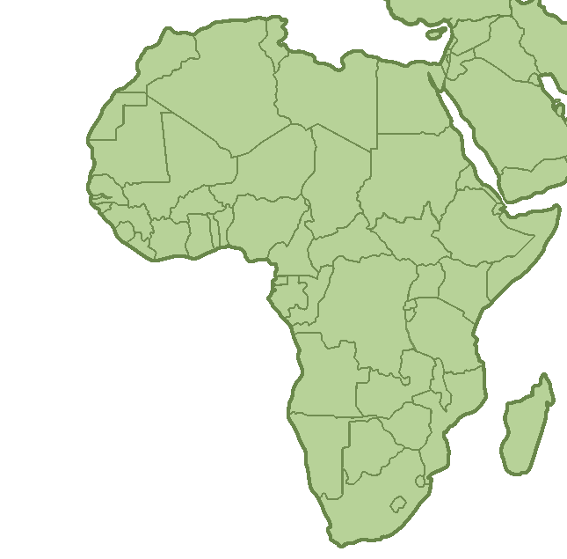
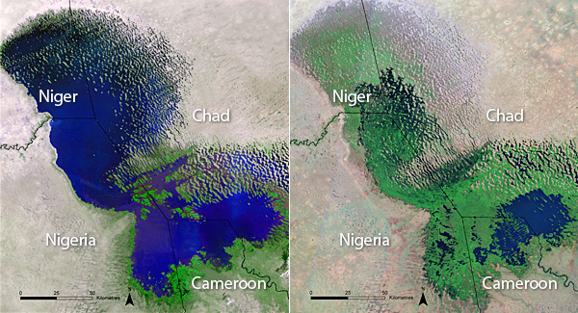
Expanding Application of Satellite Imagery to Slow-Onset Disasters
Mads O’Brien
MESc Candidate, Yale School of Forestry
December 4, 2018
Notes:
https://ourworld.unu.edu/en/sucking-dry-an-african-giant
Good morning. Today I am going to tell you why I think that satellite imagery should become a more routine part of humanitarian response, and how we can make that happen. … focusing on one problem and recommendation in particular
Satellite imagery has been used to monitor the shrinking of lake chad over time, with a focus on climate change.
However, lake chad is also home to a complex emergency (v and i have been studying all semester)
Lake Chad Basin Crisis
Violence
Displacement
Food insecurity
Lack of livelihoods

Slide 2
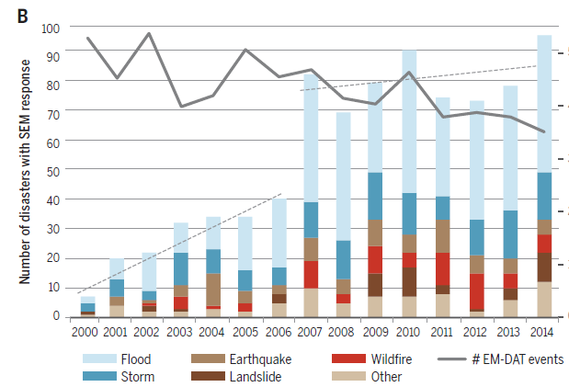
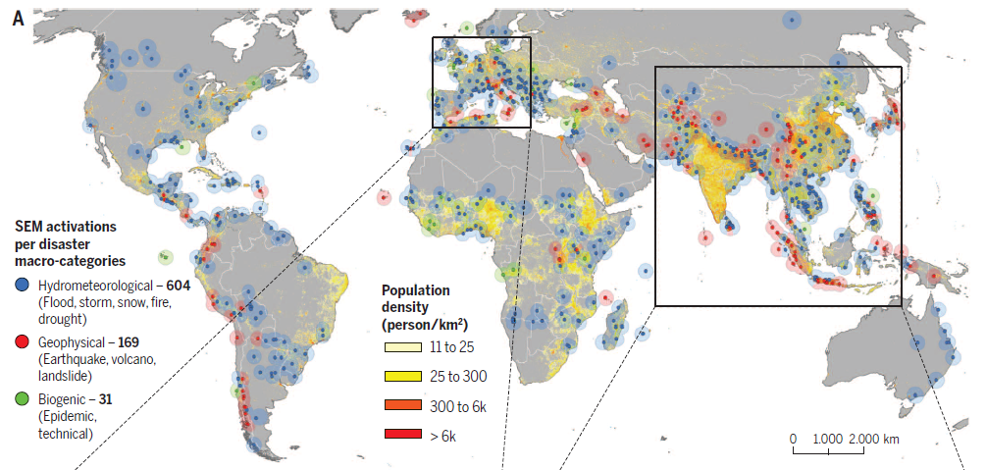
The Problem
Satellite imagery most often deployed for natural disaster response
Imagery CAN garner helpful data in slow-onset disasters
Notes:
We’ve learned in this class that satellite imagery can tell us lots of useful things in a crisis! Where refugees are moving, the buildings that insurgents have destroyed…
However, while there are some small organizations monitoring these features, like SIgnal
On a LARGE scale, satellite imagery is deployed almost exclusively in cases of fast-onset natural disaster (earthquakes, hurricanes, floods).
So what exactly is excluded here? Slow-onset disasters like famines or droughts, societal disasters like mass violence, and epidemics

Slide 3

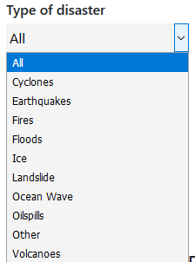
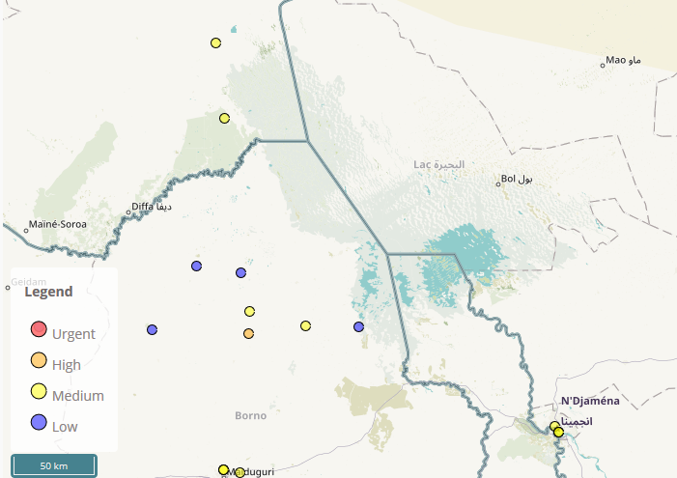

The Problem, cont’d
Pipelines for integrating satellite imagery into humanitarian response are designed for natural disasters
Voluntary Technical Organizations (VTOs) suffer from usability issues
Notes:
Because not every organization can have a satellite in the sky, most aid agencies have to request imagery that some satellite commission has already taken, or “task” the satellite to take photos in a certain spot on earth.
And the bigger problem is, the structural “pipelines” that exist for aid agencies to acquire satellite imagery, the hoops they have to jump through to get it, are designed for natural disaster type responses.
EXAMPLE: The Charter on Space and Major Disasters is an international group of space agencies and private satellite companies that an “approved user” can activate. must be “Be a national disaster management authority
Satellite imagery historically used in natural disaster response … statistically, even today, it’s being used for this more often
Thus, it makes sense that pipelines for integrating satellite imagery into humanitarian response are designed for natural disasters.
And financial and governmental support to follow those causes
https://disasterscharter.org/web/guest/about-the-charter 34 satellites can be tasked and support requesters like the UN
To be a member of charter to activate it must be “Be a national disaster management authority or its delegated agency in that country”
“Other” include the 2015 ebola crisis but then lost of crashed planes or lost ships
Now to try and fill the gaps, in the past two decades numerous volunteer technical organizations or VTOs have entered the arena, some of which we talked about in our last class. Humanitarian OSM Team pictured here feeds recent satellite imagery to a user at home and allows them to digitize features
--- however, VTOs suffer from their usability not being straightforward. Interpreting a satellite image of a place you’ve never been takes a LOT of practice and skill. And sometimes, the products of those VTOs may or may not be well suited for the need the aid organization is trying to address

Slide 4
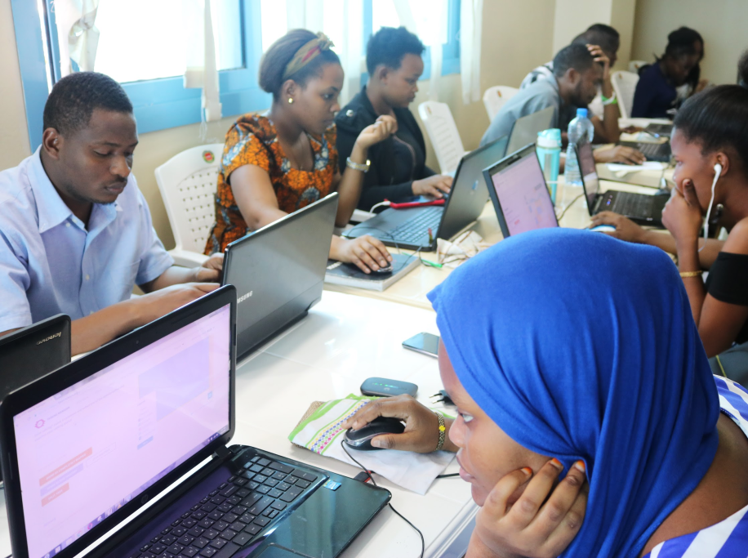
The Recommendations
Structural: Governments establish same level of support for slow-onset disasters
Use existing imagery pipelines as a “blueprint” (i.e. Charter)
Civ-Inc: Create incentives for private companies to share imagery with locales directly
VTOs: Increase usability and need-task matching
Provide better instructions for non-expert users on VTO platforms
Explain how data will be used
Notes:
For example, if UNICEF wants to use satellite imagery to monitor hostility around schools or markets,

Slide 5
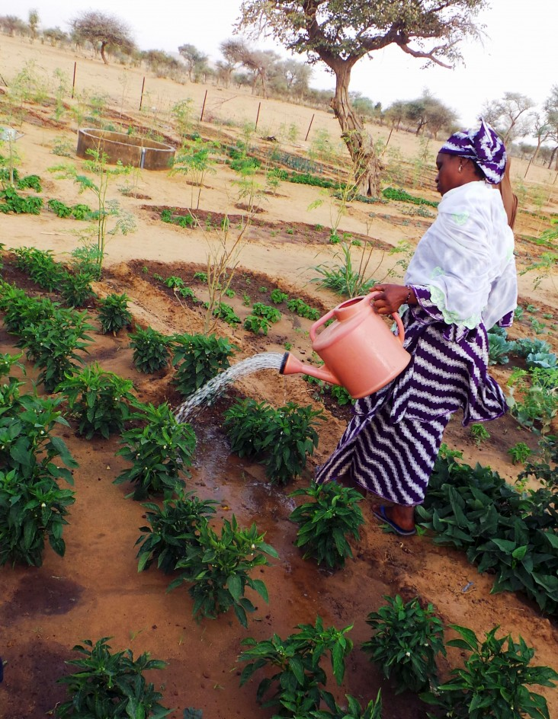
Lake Chad Basin: Applications
Assist work orgs. are already doing, but that coarse, infrequent imagery cannot assis
Monitor infrastructure near transhumance zones for repair
Water Points
Vaccination centers
Monitoring decentralized agriculture in host communities and camps
Notes:
§ Coarse resolution, low-return-time satellites are not enough to monitor these changing dynamics
§ IDPs are often given a plot of land to cultivate in host communities for livelihood and subsistence. 89 of 124 IDP camps in Nigeria have land for farming too.
§ Coarse resolution, low-return-time satellites are not enough to monitor these changing dynamics
§ Humaids should understand what biophysical factors are affecting decentralized ag like this as well

